Slide 1




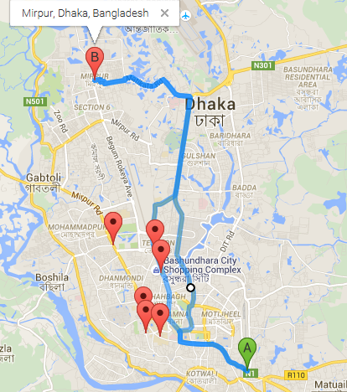
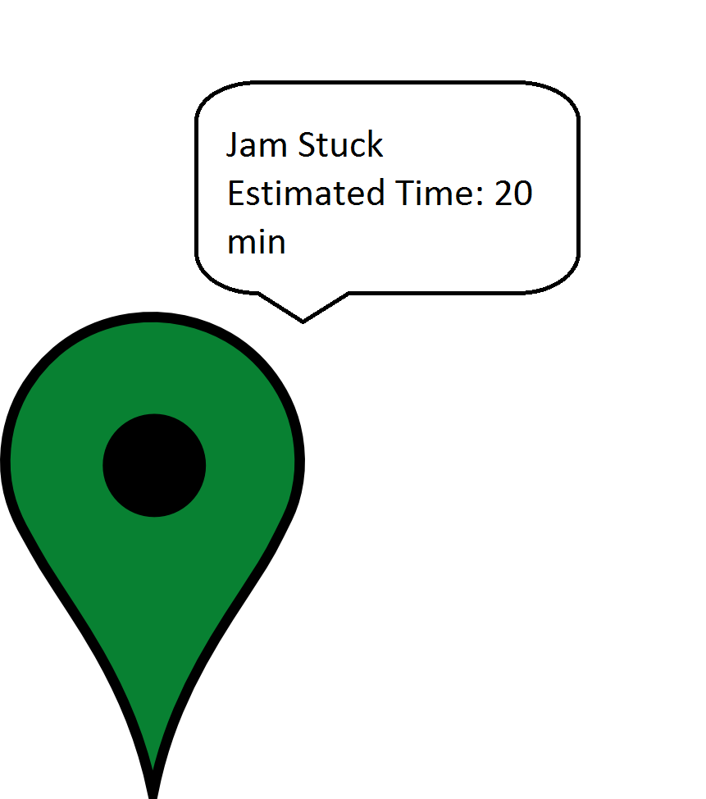
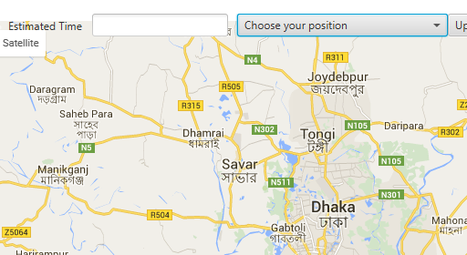

Traffic Jam Synchronizer
Late for work?
Got to Hurry?
Then comes Dhaka Traffic?
Here comes our solution for Live Traffic Update of Dhaka City
TRAFFIC JAM SYNCHRONIZER
While others are stuck in jam you know what to do….
Helps you to give input where you are stuck in jam with customized Google map
Shows you the places that are jam-struck with just one click
Shows the estimated time where the vehicles are stuck and alternate way to your destination
Markers indicating what is happening where ??
Very easy to use and a interactive apps using cloud server
Keeps updating from time to time so that you can get the latest update instantly
Enjoy Your Jam-free Life

